Slide 1
Disciplinary Committee
ONLINE CONFERENCE 17. September 2024
ORGANIZED BY THE HUNGARIAN CHAMBER OF PATENT ATTORNEYS
Presentation of the Chairperson of the epi Disciplinary Committee
Disciplinary System within the European Patent Organization (EPOrg)
and some real cases against European Patent Attorneys before Disciplinary Bodies of the EPOrg
.

Slide 2
Disciplinary Bodies of the EPOrg
The Regulation on Discipline has identified the following three disciplinary bodies of the EPOrg
Article 5: Disciplinary bodies
Infringements of the Rules of Professional Conduct may be considered by the following bodies:
(a) the Disciplinary Committee of the Institute of Professional Representatives before the European Patent Office,
(b) the Disciplinary Board of the European Patent Office,
(c) the Disciplinary Board of Appeal of the European Patent Office.
Under this provision DC is related to the other two disciplinary bodies of the European Patent Organization. Based on this relationship the decisions of DC can be appealed at the Disciplinary Board of Appeal.
.
Disciplinary Committee

Slide 3
Overview
Disciplinary Committee
Administrative Council
EPO
Boards of Appeal
epi
DB
time
DC
epi Council
important cases
38 Members, budget

Slide 4
Basic Principles of Conduct for the epi Members and Terms of Reference for
Disciplinary Bodies to follow
The EPO Administrative Council has identified in the first 3 Articles of the Regulation on Discipline the three basic principles of professional conduct. These are the basic terms of reference that the disciplionary Organs must follow in their deliberations of a compliant.
The principle of responsibility towards the profession: Article 1: A professional representative shall exercise his profession conscientiously and in a manner appropriate to its dignity. In particular, he shall not knowingly make any false or misleading statement.
.
Disciplinary Committee

Slide 5
Basic Principles of Conduct for the epi Members and Terms of Reference for
Disciplinary Bodies to follow
2) The principle of confidence in the profession: Article 2: A professional representative shall conduct himself in such a manner as not to prejudice the necessary confidence in his profession. A professional representative shall be bound not to disclose information accepted by him in confidence in the exercise of his duties, unless he is released from this obligation.
3) The principle of responsibility towards the client: Article 3: A professional representative who is unwilling to accept a call upon his professional services or who withdraws his services shall forthwith inform the client. In the latter case, he shall take appropriate measures to enable the client to avoid detriment.
.
Disciplinary Committee

Slide 6
Disciplinary Committee
EN: Disciplinary Committee (DC)
DE: Disziplinarrat
FR: Commission de discipline
.

Slide 7
Disciplinary Committee
Tasks
First half of First Instance in Disciplinary Proceedings
Clarification, collection of the facts
Mediation where possible
Providing Disciplinary Judgements on a first level
Forwarding cases to the more powerful D-Board
Assist epi’s stand in the public, serve the Members in order to keep high reputation of our profession

Slide 8
Independence of the Disciplinary Committee
Regulation on Discipline provides a clear statement as to the independence of the Disciplinary Committee along with the other disciplinary bodies while performing its duties.
The Regulation on Discipline Article 11:
The members of disciplinary bodies shall be independent in the performance of their duties and in particular shall not be bound by any instructions in reaching their decisions.
> epi Members may rest assured, that their cases are treated independent of eventual positions and situations at epi/EPO level.
.
Disciplinary Committee

Slide 9
Decisions of the Chambers of DC
Decisions of the DC are final within the epi, subject to appeal at the Disciplinary Board of Appeal of EPO. Once a Chamber renders its decision it cannot be considered by the Council of the Institute. However, the epi President may appeal the decision at the Disciplinary Board of Appeal of EPO.
This is provisioned under Article 8 of the Regulations on Discipline as:
(1) The Disciplinary Board of Appeal shall hear appeals against final decisions, including dismissals, of the Disciplinary Committee of the Institute and the Disciplinary Board of the European Patent Office.
2) Appeals may be filed by the professional representative concerned, the President of the Council of the Institute and the President of the European Patent Office.
.
Disciplinary Committee

Slide 10
Disciplinary Committee
Powers and Responsibilities of the Disciplinary Committee
As provisioned in Article 6 of the Regulation on Discipline in a clear statement,
The Disciplinary Committee shall consider any alleged breach of the Rules of
Professional Conduct which may be brought to its notice in writing.
After making the necessary inquiries and examination of the alleged breach, DC
can decide either to:
(a) dismiss the matter;
(b) issue a warning or reprimand, or
(c) refer the matter, together with the relevant papers, to the Disciplinary Board
of the European Patent Office. In that case the DB decides final for the first
instance.
Appeal at DBoA is possible for the Presidents and the Defendend

Slide 11
Disciplinary Committee
Past Annual Meeting of the DC
Training topic:
Training on the topic “Conflict of Interest”
Nanno Lenz and Gunnar Meyer
The NO perspective of a “relatively small country”
The DE perspective of a “relatively large country”
epi DC Chambers needs to find the right perspective for the individual case.
The papers are available for interested Board Members

Slide 12
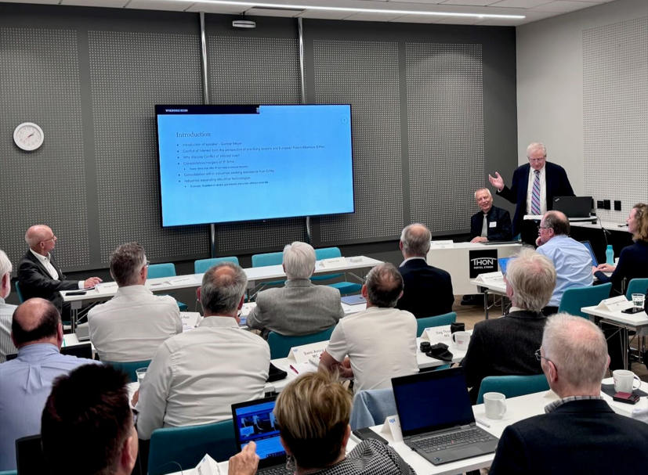
Disciplinary Committee
Past Annual Meeting of the DC

Slide 13
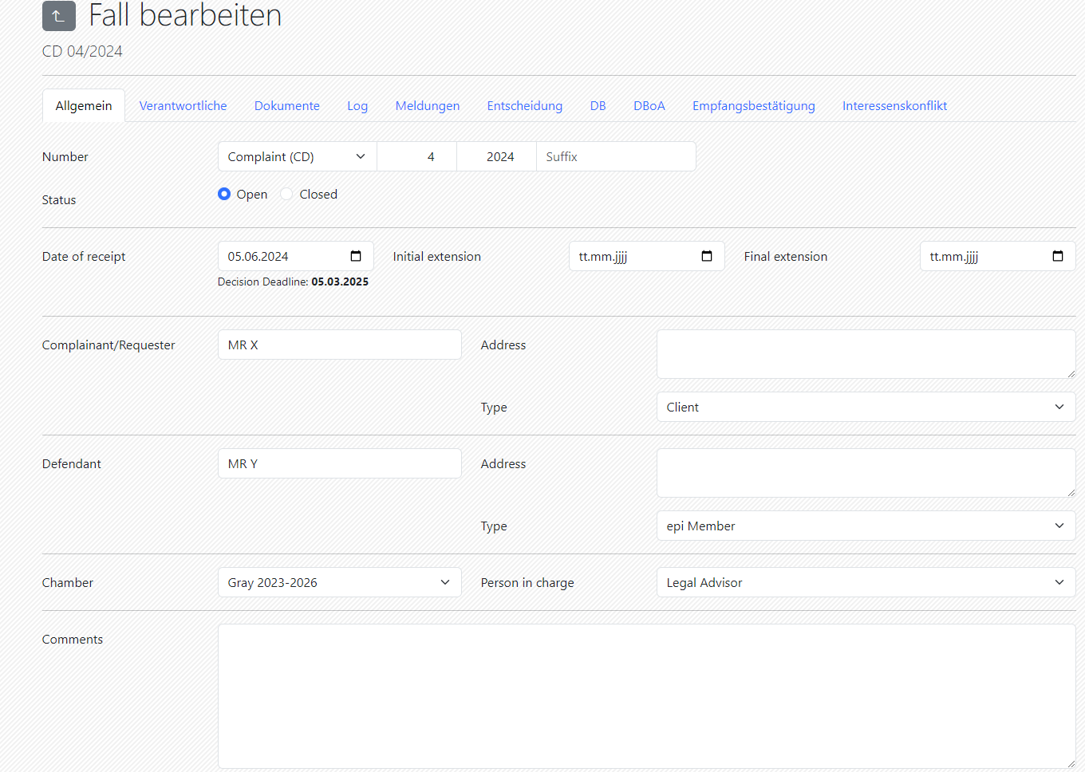
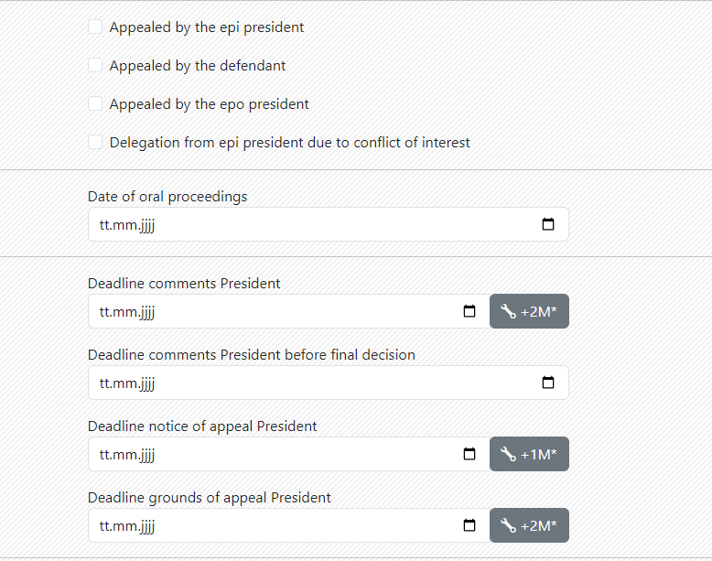
Disciplinary Committee
Backend – case details Registrars
Assignment of a DC case with all details and deadlines

Slide 14
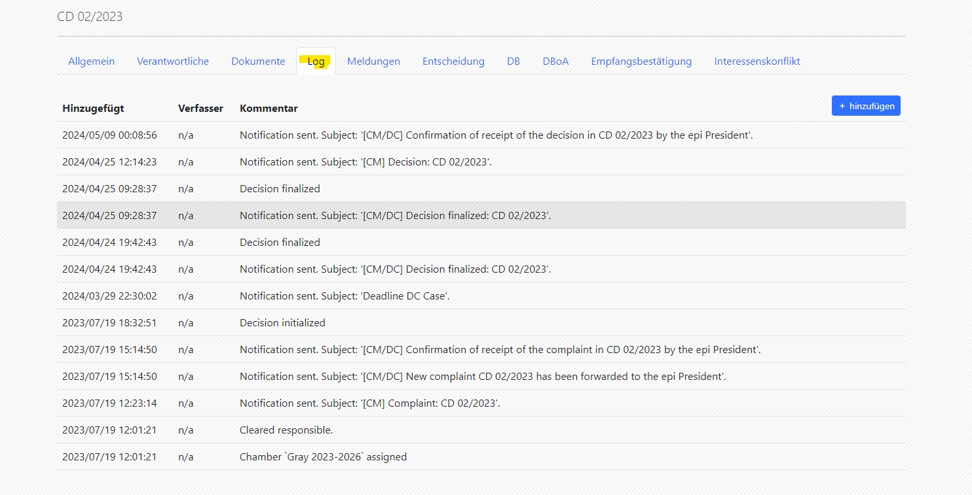
Disciplinary Committee
Backend – case details Registrars
Track of any action in the system:

Slide 15
Disciplinary Committee
Statistical information about current work
The Chambers of the DC treat currently 7 open cases two of them from 2023 and five of them from 2024.

Slide 16
Disciplinary Committee
Statistical information about appeals against DC-decisions
Out of the last 10 appealed cases (some double appealed):
1 Appeal is still pending
3 Appeals led to an at least partly overrule of the DC-Decision 9 Appeals were rejected as inadmissible.

Slide 17
Disciplinary Committee
Discussion of interesting cases
CD 06/2024:
An epi member informed epi (by forwarding an e-mail sent to the national Patentanwaltskammer) that he had taken over representation of clients from a representative since the clients had unsuccessfully tried to contact that representative for several months
Serious omissions were made by that representative in the prosecution of several patent applications before the EPO
The DC tried to reach the representative to verify that he was still alive
The DC contacted the local police, the German Patentanwaltskammer, and the EPO/Chair of DB
The Chair of the DC decided to treat the information as a complaint
Information was received thereafter that the representative is active in another EPO-Member State filing patent applications from there

Slide 18
Disciplinary Committee
Discussion of interesting cases
CD 04/2024:
Complaint filed by members of a technical Board of Appeal
Alleged infringement of Art 1(1) and (2) RDR and Art 6 Code of Conduct
Representative allegedly insulted the legally qualified Chair and the other Board members by accusing them of not trying to understand the technical details of the invention and stating that it was not expedient to discuss technical aspects with the legally qualified Chair
The epi President filed comments in this case with suggestions for research, advising to publish the decision, and pointing out that this topic will be discussed with the management of the Boards of Appeal

Slide 19
Decisions of the Disciplinary Board of Appeal (“DBA”)

Slide 20
D 1/20: Facts
Decision of 24 April 2023
Appellant: epi President
DC case: CD 08/2019
Facts:
Use of "IP attorney" on company's website for two not yet qualified employees
Use of "European Patent Litigator" on company's website

Slide 21
D 1/20: Reasoning DBA
The board considers that a significant number of visitors to the website of the professional representative concerned are likely to assume that the persons having the title "IP attorney" are entitled to represent clients e.g. before the EPO, or, more generally, to represent clients without the involvement of another professional colleague.
Hence, use of "IP attorney“ for not yet qualified employees:
- is likely to deceive the target public
- is therefore to be regarded as "misleading"
Member acted "knowingly“ since aware of circumstances and potential misleading use
Hence, infringement of Art 1(1) RDR and Sec. 3(b) CoC

Slide 22
Disciplinary Committee
Discussion of interesting cases
CD 04/2021 = D1/2022:
A Dutch professional representative and
member of the Institute of Professional Represent-atives before the EPO ("epi"), had failed to transfer a
Belgian patent from a company owned by the complainants
to them as individuals, resulting in the lapse of the
patent. Nevertheless, the defendant had continued to
charge the complainants renewal fees for the patent as
well as processing fees via the defendant's former
company and his current place of business.

Slide 23
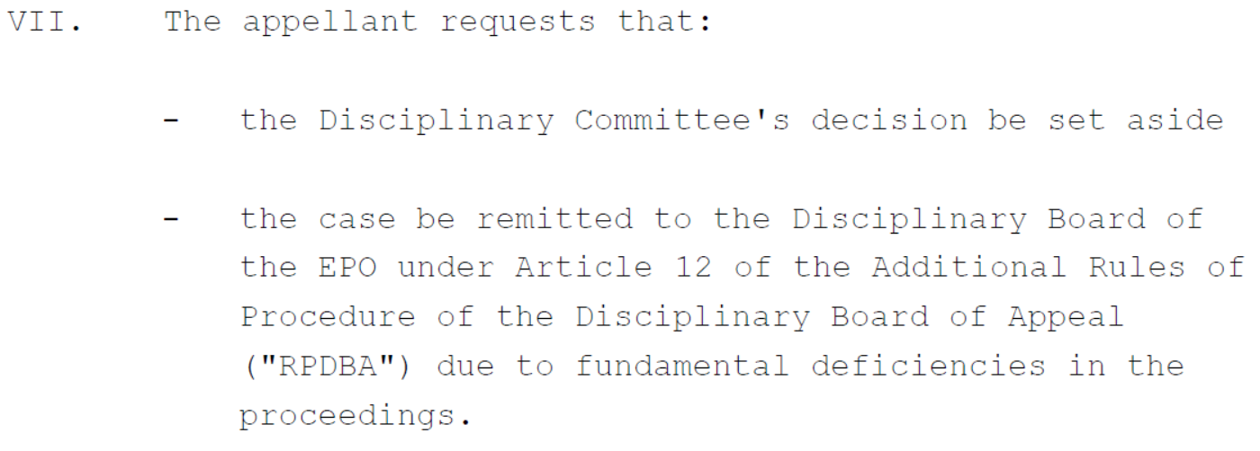
Disciplinary Committee
Discussion of interesting cases
CD 04/2021 = D1/2022:

Slide 24
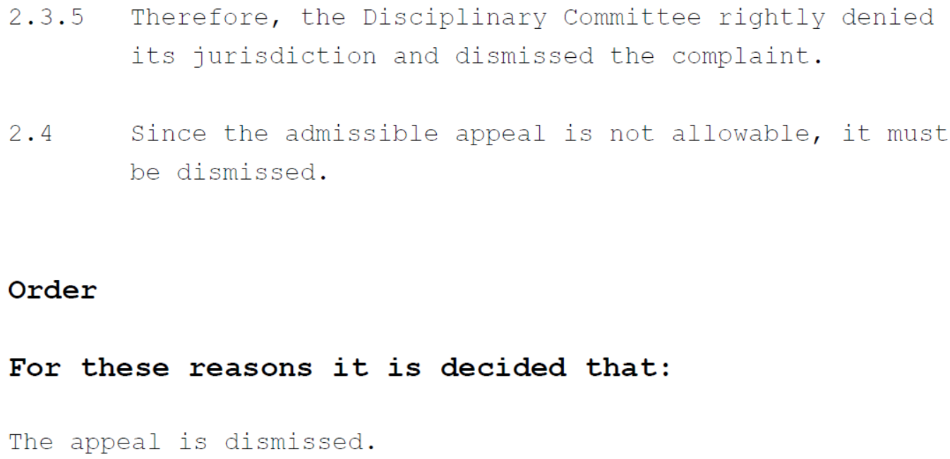
Disciplinary Committee
Discussion of interesting cases
CD 04/2021 = D1/2022:

Slide 25
Disciplinary Committee
Coverage of the EPOrg’s Disciplinary System
Currently it seems that
Only actions related to European patents and patent applications including national entries thereof and including actions related to annuities for such national entries and general indications on office premises, stationery etc. and
Activities of European Patent Attorneys (ePA) before the UPC
are covered by the EPOrg Disciplinary System.
Future Coverage: War-related activities (sanctions) of ePA’s?

Slide 26
Disciplinary Committee
Thank You!
In case of questions or proposals, the Chairs of DC are available
Paul Rosenich rosenich@pprag.com
Werner Fröhling werner.froehling@swisskrono.com
Most relevant Law for Disciplinary Questions:
epi Code of Conduct
https://www.epo.org/en/legal/official-journal/2022/06/a61.html
Regulation on Discipline:
https://www.epo.org/en/legal/official-journal/2022/etc/se1/p142.html

